Slide 1
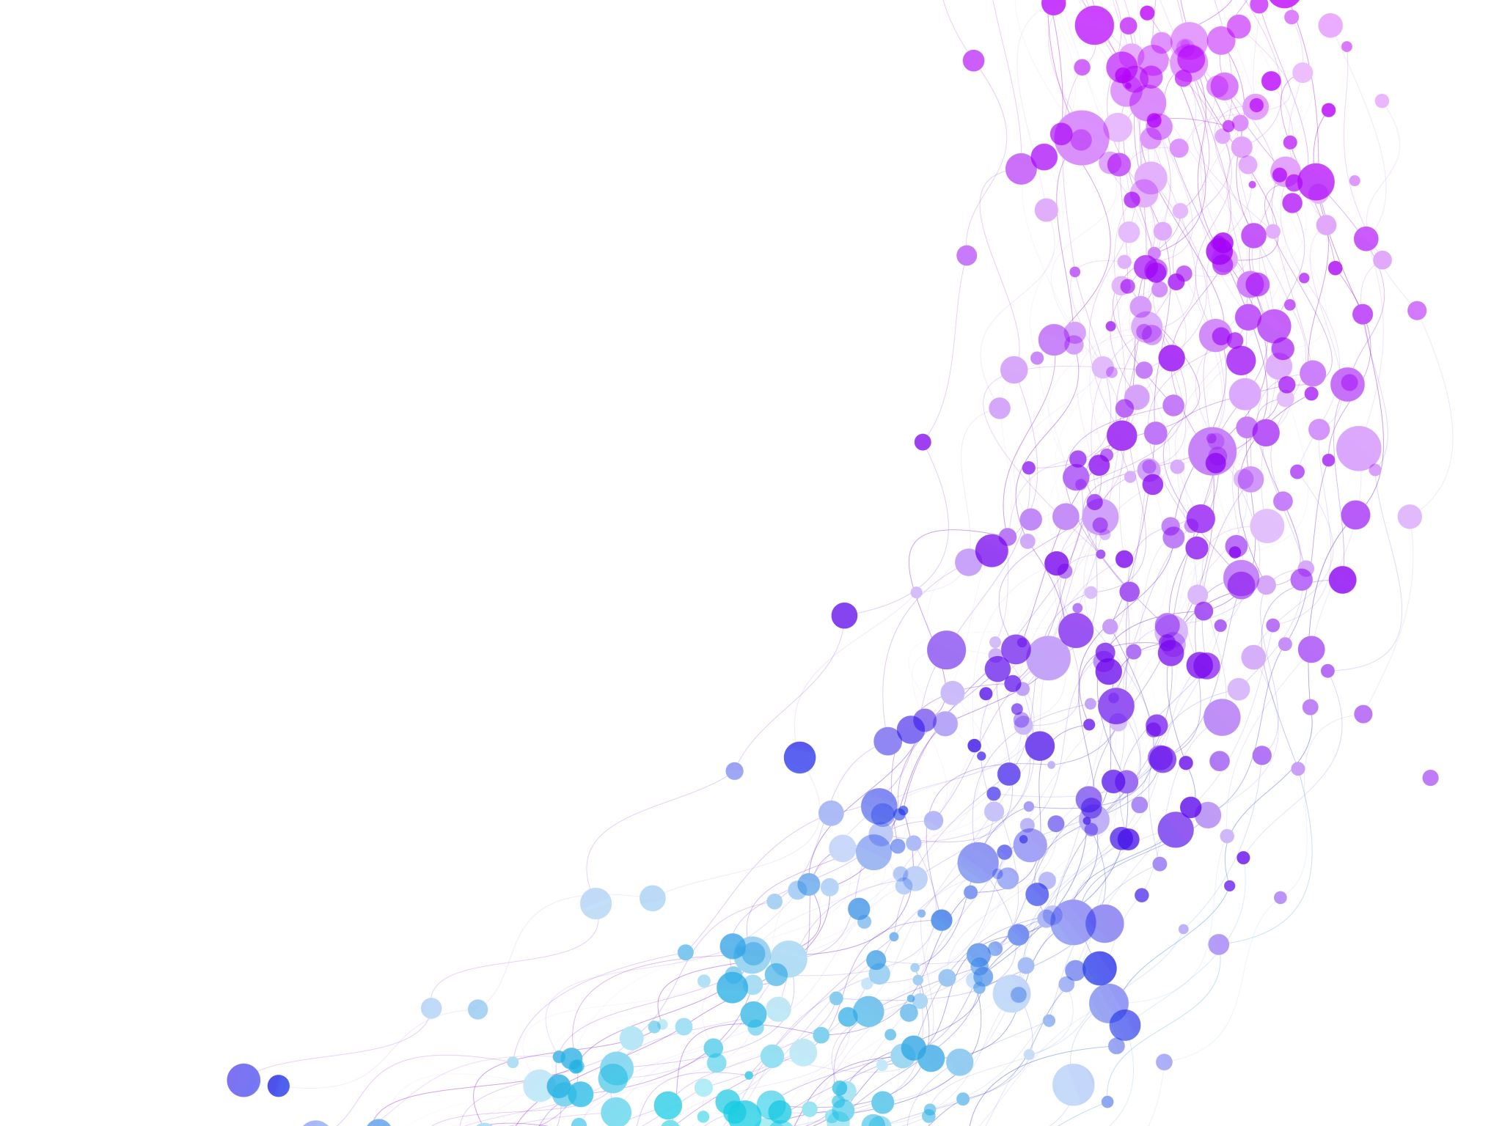


Application of arrays, Sparse Matrices, and their representations Session No.: 6 Course Name: Data Structures Course Code: R1UC308B Instructor Name: Dr. Gaurav Agarwal Duration: 50 mins Date of Conduction of Class: 29 Aug 2025

Slide 2

Review
Array Type | Order | Formula | Parameters
1D Array | – | Addr(A[Index]) = B + W × (Index – LB) | B = Base address W = Size of one element (bytes) LB = Lower bound of index
2D Array | Row Major | Addr(A[I][J]) = B + W × ( M × (I – LR) + (J – LC) ) | B = Base address W = Element size LR = Row lower bound LC = Column lower bound M = Number of columns
2D Array | Column Major | Addr(A[I][J]) = B + W × ( (I – LR) + N × (J – LC) ) | N = Number of rows (other symbols as above)
3D Array | Row Major | Addr(A[I][J][K]) = B + W × ( N × L × (I – x) + L × (J – y) + (K – z) ) | B = Base address W = Element size N = Depth/Height M = Rows L = Columns x, y, z = Lower bounds
3D Array | Column Major | Addr(A[I][J][K]) = B + W × ( N × L × (I – x) + (J – y) + (K – z) × N ) | Same as above

Slide 3
Learning Outcomes
[2-mins]
By the end of this session, You will be able to:
Identify real-world applications where arrays are used efficiently
Explain and implement sparse matrix representations using arrays and linked lists

Slide 4

Pre-Class Assessment
[2-mins]

Slide 5
Session Outline
Different Applications of Arrays
Representation of Sparse Matrix using Arrays.
Representation of Sparse Matrix using linked lists.
Provide hands-on activities and reinforce learning through an interactive WooClap and WooFlash tools.

Slide 6
Application of arrays
Storing and accessing data
Arrays are used to store and retrieve data in a specific order.
For example, an array can be used to store the scores of a group of students, or the temperatures recorded by a weather station.
Sorting
Arrays can be used to sort data in ascending or descending order.
Sorting algorithms such as bubble sort, merge sort, and quicksort rely heavily on arrays.
Searching
Arrays can be searched for specific elements using algorithms such as linear search and binary search.
Matrices
Arrays are used to represent matrices in mathematical computations such as matrix multiplication, linear algebra, and image processing.

Slide 7
Application of arrays
Stacks and queues
Graphs
Arrays can be used to represent graphs in computer science.
Dynamic programming
Dynamic programming algorithms often use arrays to store intermediate results of subproblems to solve a larger problem.
commonly used in algorithms and data structures.
Arrays are used as the underlying data structure for implementing stacks and queues, which are
Each element in the array represents a node in the graph, and the relationships between the nodes are represented by the values stored in the array.
Image processing
Arrays are commonly used to store the pixel values of an image.
For example, a two-dimensional array can be used to store the RGB values of an image.

Slide 8

[3-mins]
If you have a timetable stored as a 1000×1000 matrix but only 20 entries are non-zero, would you still waste memory storing all the zeros? How else can we represent it efficiently?

Slide 9
Sparse Matrices and their representations
Why?
Storage
There are lesser non-zero elements than zeros and thus, lesser memory can be used to store only those elements.
Computing time
Computing time can be saved by logically designing a data structure traversing only non-zero elements.
A matrix is a two-dimensional data object made of n rows and m columns, therefore having total mxn values.
If most of the elements of the matrix have 0 value, then it is called a sparse matrix.

Slide 10
Representation of Sparse Matrices
Representing a sparse matrix by a 2D array leads to wastage of lots of memory as zeroes in the matrix are of no use in most of the cases.
So, instead of storing zeroes with non-zero elements, we only store non-zero elements.
This means storing non-zero elements with triples
(Row, Column, value).
Sparse Matrix Representations can be done in many ways following are two common representations:
Array representation
Linked list representation

Slide 11
Method 1: Array Representation
2D array is used to represent a sparse matrix in which there are three rows named as
Row: Index of row, where non-zero element is located
Column: Index of column, where non-zero element is located
Value: Value of the non-zero element located at index – ( row, column )

Slide 12
Method 1: Array Representation
int sparse[4][6] = {
{0, 0, 3, 0, 0, 4},
{0, 0, 5, 7, 0, 0},
{0, 0, 0, 0, 0, 0},
{0, 2, 6, 0, 0, 0}
};
int rows = 4, cols = 6;
int size = 0;
for (int i = 0; i < rows; ++i)
for (int j = 0; j < cols; ++j)
if (sparse[i][j] != 0) ++size;
int compact[3][size];
int k = 0;
for (int i = 0; i < rows; ++i) {
for (int j = 0; j < cols; ++j) {
if (sparse[i][j] != 0) {
compact[0][k] = i; // row index
compact[1][k] = j; // column index
compact[2][k] = sparse[i][j]; // value
++k;
}
}
}

Slide 13
Method 2: Using Linked Lists
In linked list, each node has four fields. These four fields are defined as:
Row: Index of row, where non-zero element is located
Column: Index of column, where non-zero element is located
Value: Value of the non-zero element located at index – (row,column)
Next node: Address of the next node

Slide 14
Arithmetic operations on matrices
Addition of Matrix
Subtraction of Matrix
Scaler Multiplication of Matrix
Multiplication of Matrix
Transpose
Inversion

Slide 15
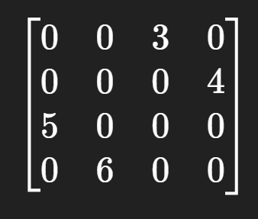
Activity: Experiential Learning
Given this Matrix:
Instructions for Students
Work in pairs within your group.
Be ready to explain your approach to the rest of the group.
Pair 1: Array Representation (2D Matrix Form)
Pair 2: Linked List Representation
Pair 3: Matrix Operation – Transpose
Each pair will present their solution to their group.
Groups will compare answers and discuss the efficiency of each representation.

Slide 16

Post-Class Assessment
[2-mins]
https://app.wooflash.com/moodle/W1LZZ8FG
Wooflash Code: W1LZZ8FG
Join the link and Participate in Post-class Assessment

Slide 17
Summary
[1-mins]
Arrays are widely used in storing, sorting, searching, and implementing data structures like stacks, queues, and graphs.
Sparse matrices save storage and computation by storing only non-zero elements instead of the full matrix.
Sparse matrices can be represented using 3-tuple arrays or linked lists for efficient memory use.
Matrix operations like addition, subtraction, transpose, and multiplication can also be efficiently applied on sparse matrices.

Slide 18
[2-mins]
Ensure attainment of LO’s in alignment to the learning activities:
Explain the process of deriving index formula for 1-D, 2-D, and multi-D arrays in both row-major and column-major order
Apply the formula to calculate the memory address of given elements in 1D, 2D and 3D arrays under different storage orders

Slide 19
[1-min]
Next Session:
Application of arrays, Sparse Matrices, and their representations

Slide 20
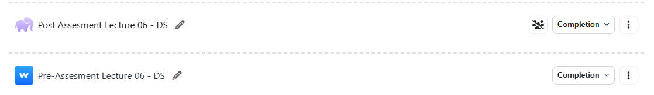
Review and Reflection from students

